Slide 1
Learning from Examples
Chapter 18

Slide 2
Outline
Regression and Classification with Linear Models
Artificial Neural Network

Slide 3
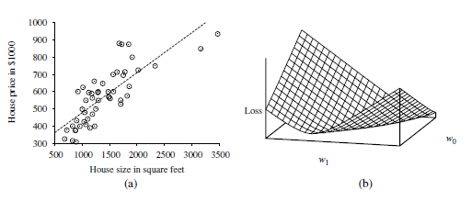
Univariate linear regression
A univariate linear function (a straight line) with input x and output y has the form y =w₁x+ w₀
We’ll define w to be the vector [w₀,w₁], and define
h_{w}(x)=w₁x + w₀
The task of finding the h_{w} that best fits these data is called linear regression.

Slide 4
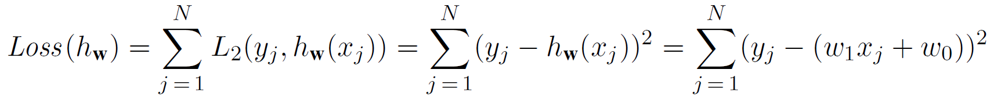
Univariate linear regression
We’ll define w to be the vector [w₀,w₁], and define
h_{w}(x)=w₁x + w₀
The task of finding the h_{w} that best fits these data is called linear regression.

Slide 5
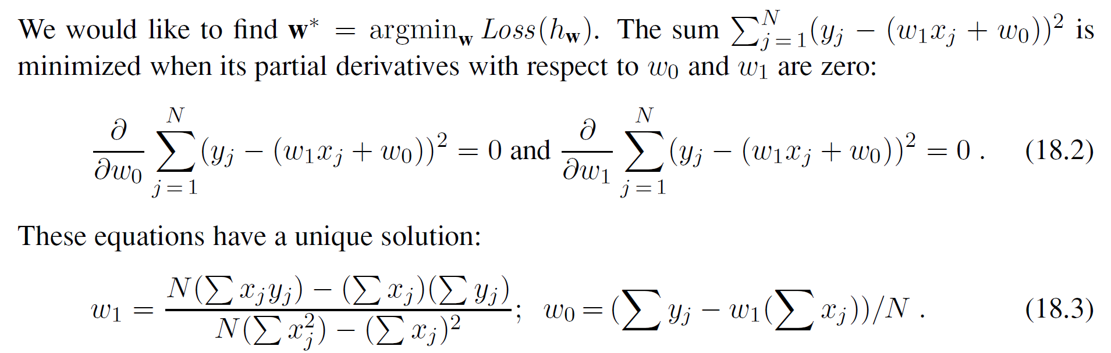
Univariate linear regression

Slide 6
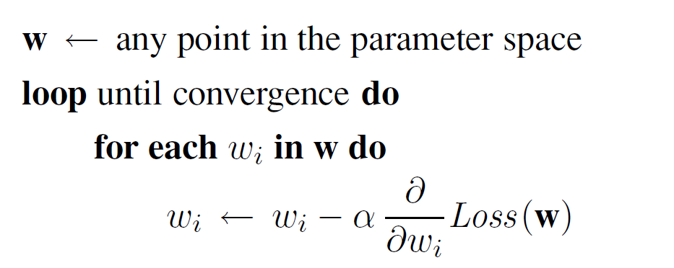
Univariate linear regression
Learning rate

Slide 7
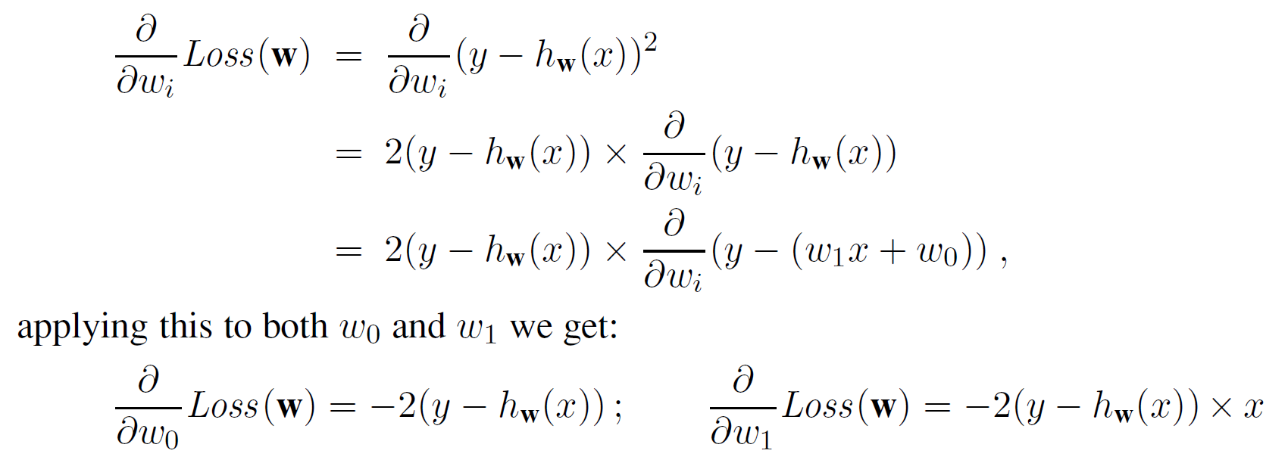
Univariate linear regression

Slide 8
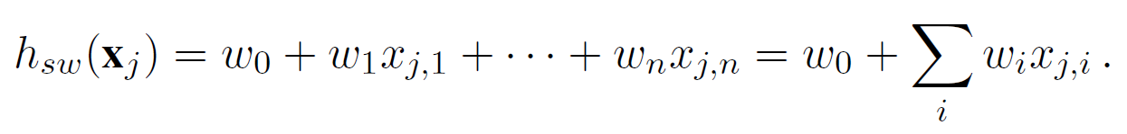
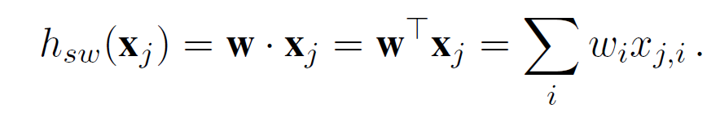
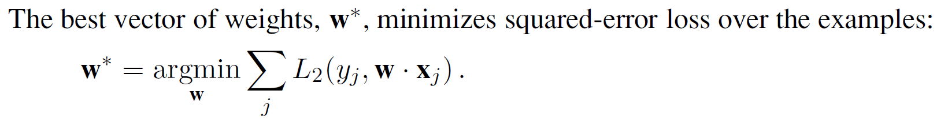
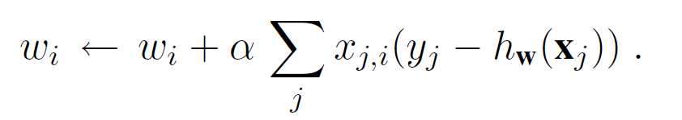
Multivariate linear regression
We can extend to multivariate linear regression problems, in which each example x_{j} is an n-element vector
Solve by gradient descent:

Slide 9
Regularization
It is common to use regularization on multivariate linear functions to avoid overfitting.
Recall that with regularization we minimize the total cost of a hypothesis, counting both the empirical loss and the complexity of the hypothesis

Slide 10
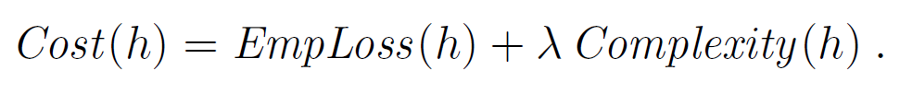
Regularization
It is common to use regularization on multivariate linear functions to avoid overfitting.
Recall that with regularization we minimize the total cost of a hypothesis, counting both the empirical loss and the complexity of the hypothesis

Slide 11
Regularization
It is common to use regularization on multivariate linear functions to avoid overfitting.
Recall that with regularization we minimize the total cost of a hypothesis, counting both the empirical loss and the complexity of the hypothesis

Slide 12
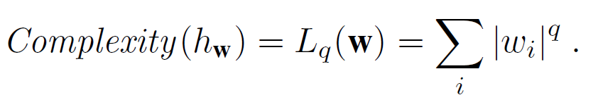
Regularization
It is common to use regularization on multivariate linear functions to avoid overfitting.
Recall that with regularization we minimize the total cost of a hypothesis, counting both the empirical loss and the complexity of the hypothesis

Slide 13
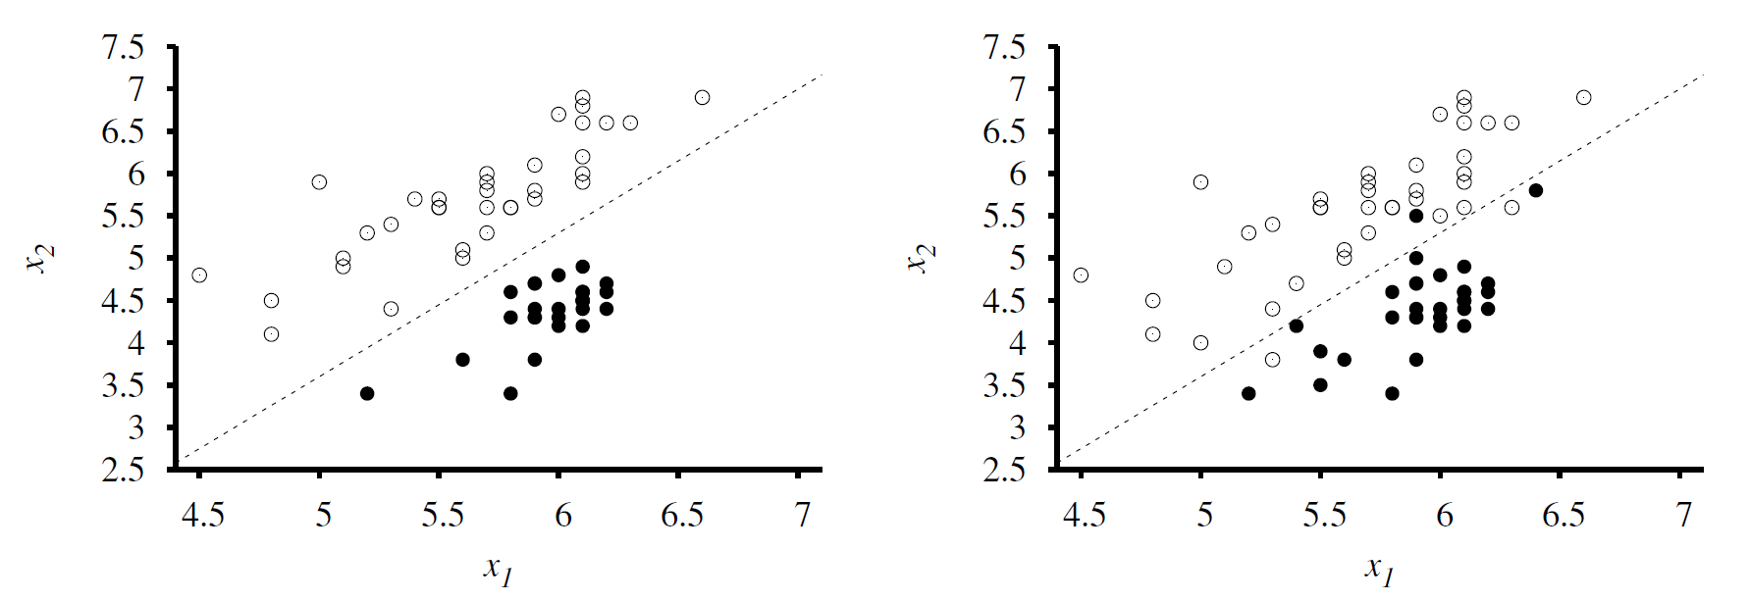
Linear classifier

Slide 14
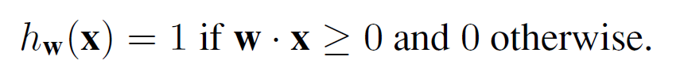
Linear classifier
A decision boundary is a line (or a surface, in higher dimensions) that separates the two classes.
Classification hypothesis

Slide 15
Linear classifier
A decision boundary is a line (or a surface, in higher dimensions) that separates the two classes.
Classification hypothesis

Slide 16
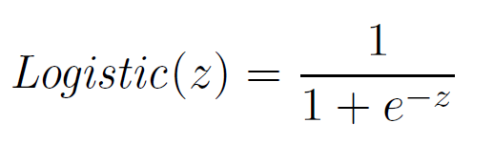
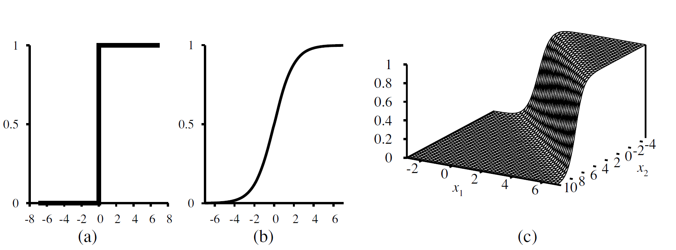
Logistic regression
Extent by softening the threshold function—approximating the hard threshold with a continuous, differentiable function.
The answer is logistic function.
Notes:
不可微时，用一个连续的函数表示阈值

Slide 17
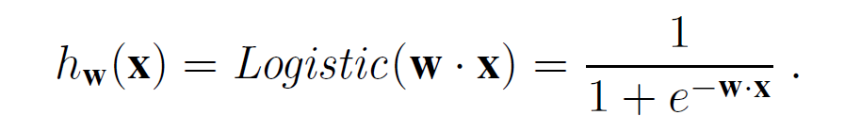
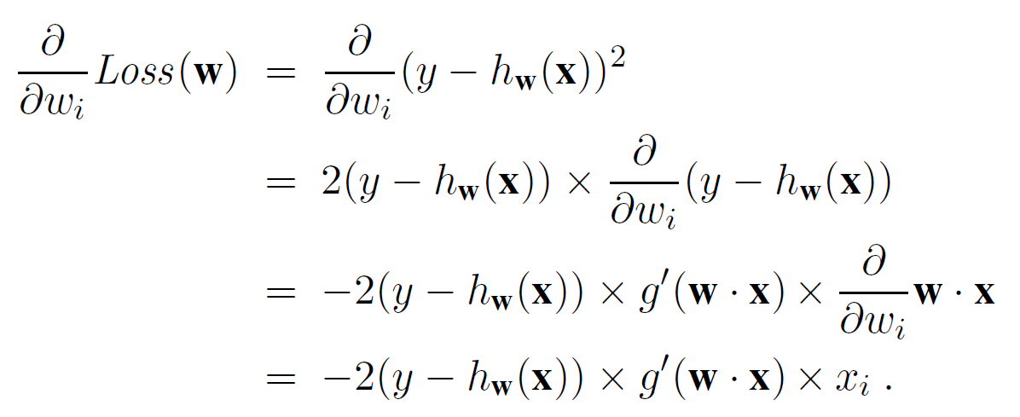
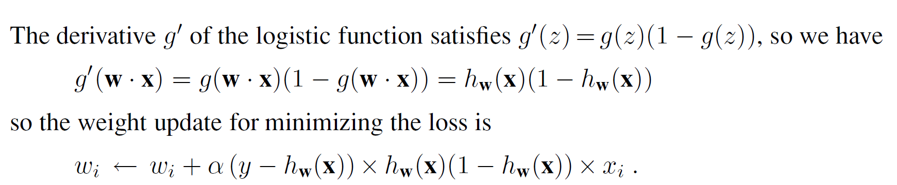
Logistic regression classifier
With the logistic function replacing the threshold function
Solve by chain rule

Slide 18
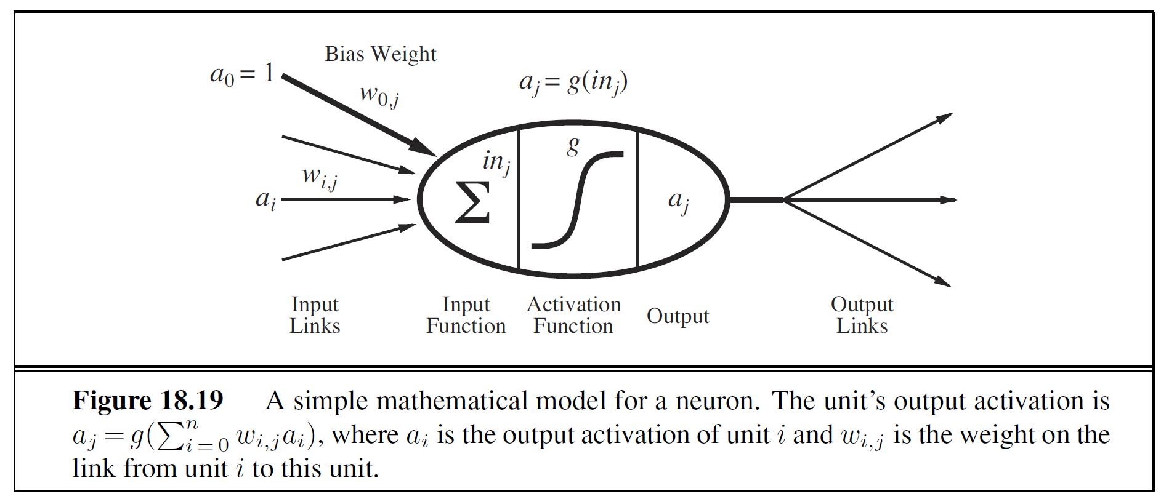
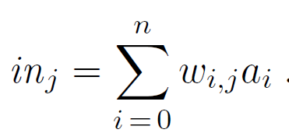
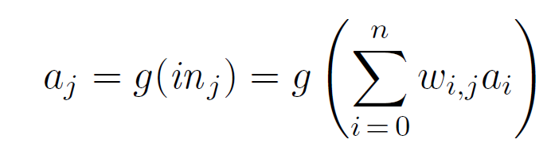
Neural network

Slide 19
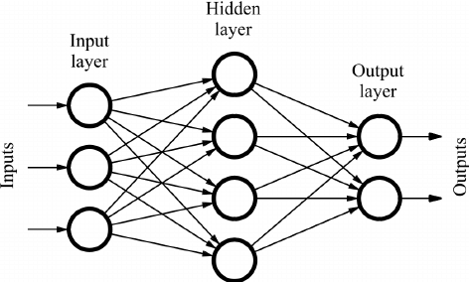
Feed-forward network

Slide 20
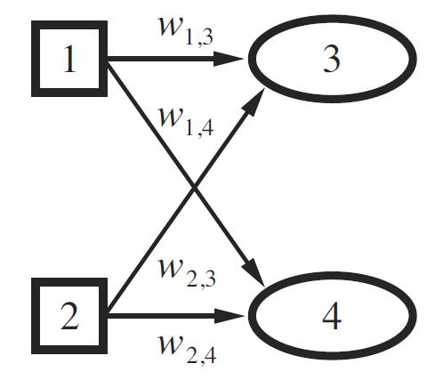
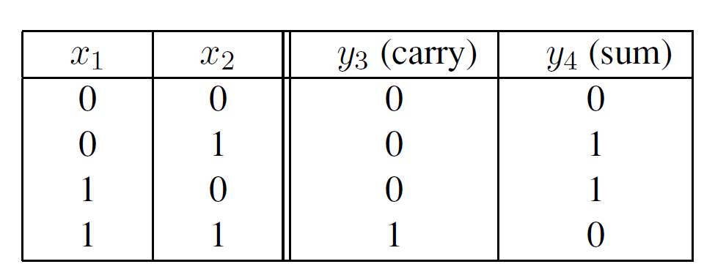
Perceptron network
Training data to learn the two-bit adder function
A perceptron network with two inputs and two output units
Notes:
Single-layer feed-forward neural networks
学习一个2bit的加法器, carry 进位， sum求和

Slide 21
Perceptron network
Training data to learn the two-bit adder function
A perceptron network with two inputs and two output units

Slide 22
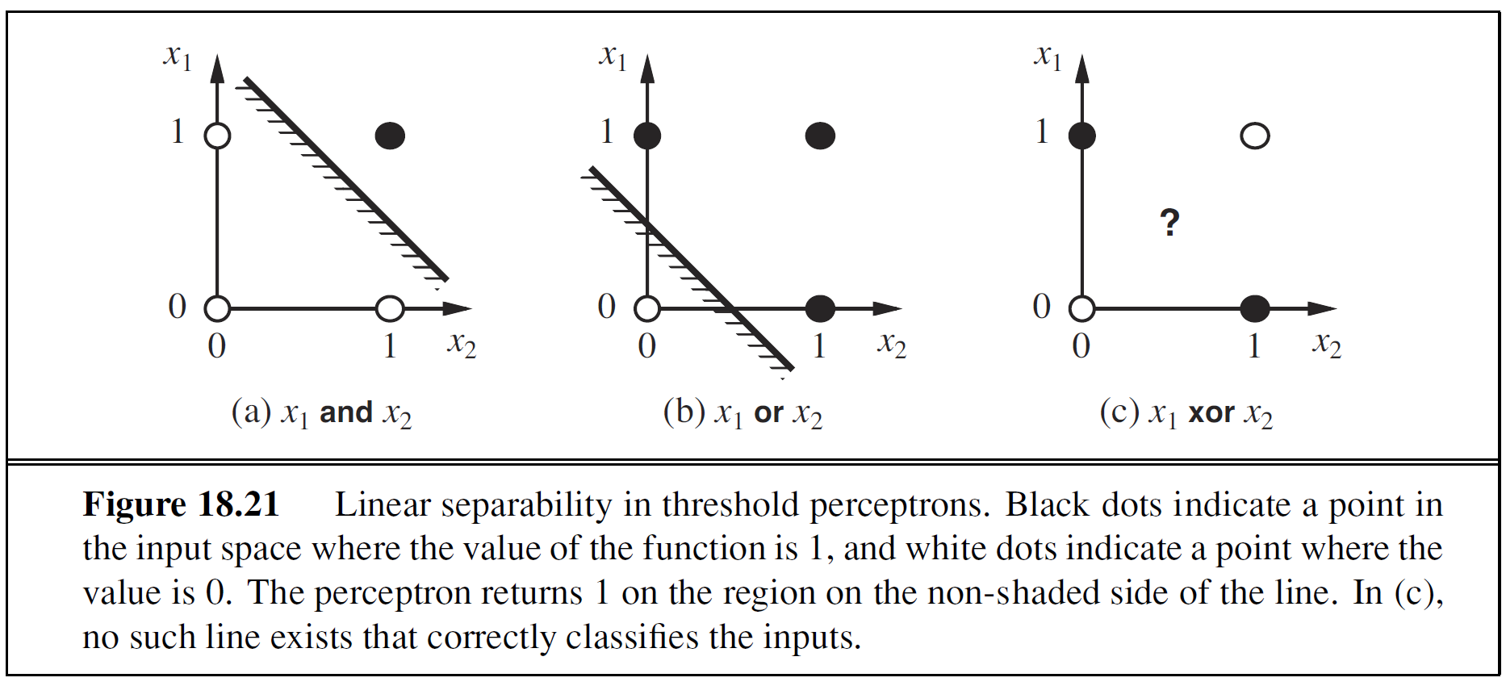
Perceptron network

Slide 23
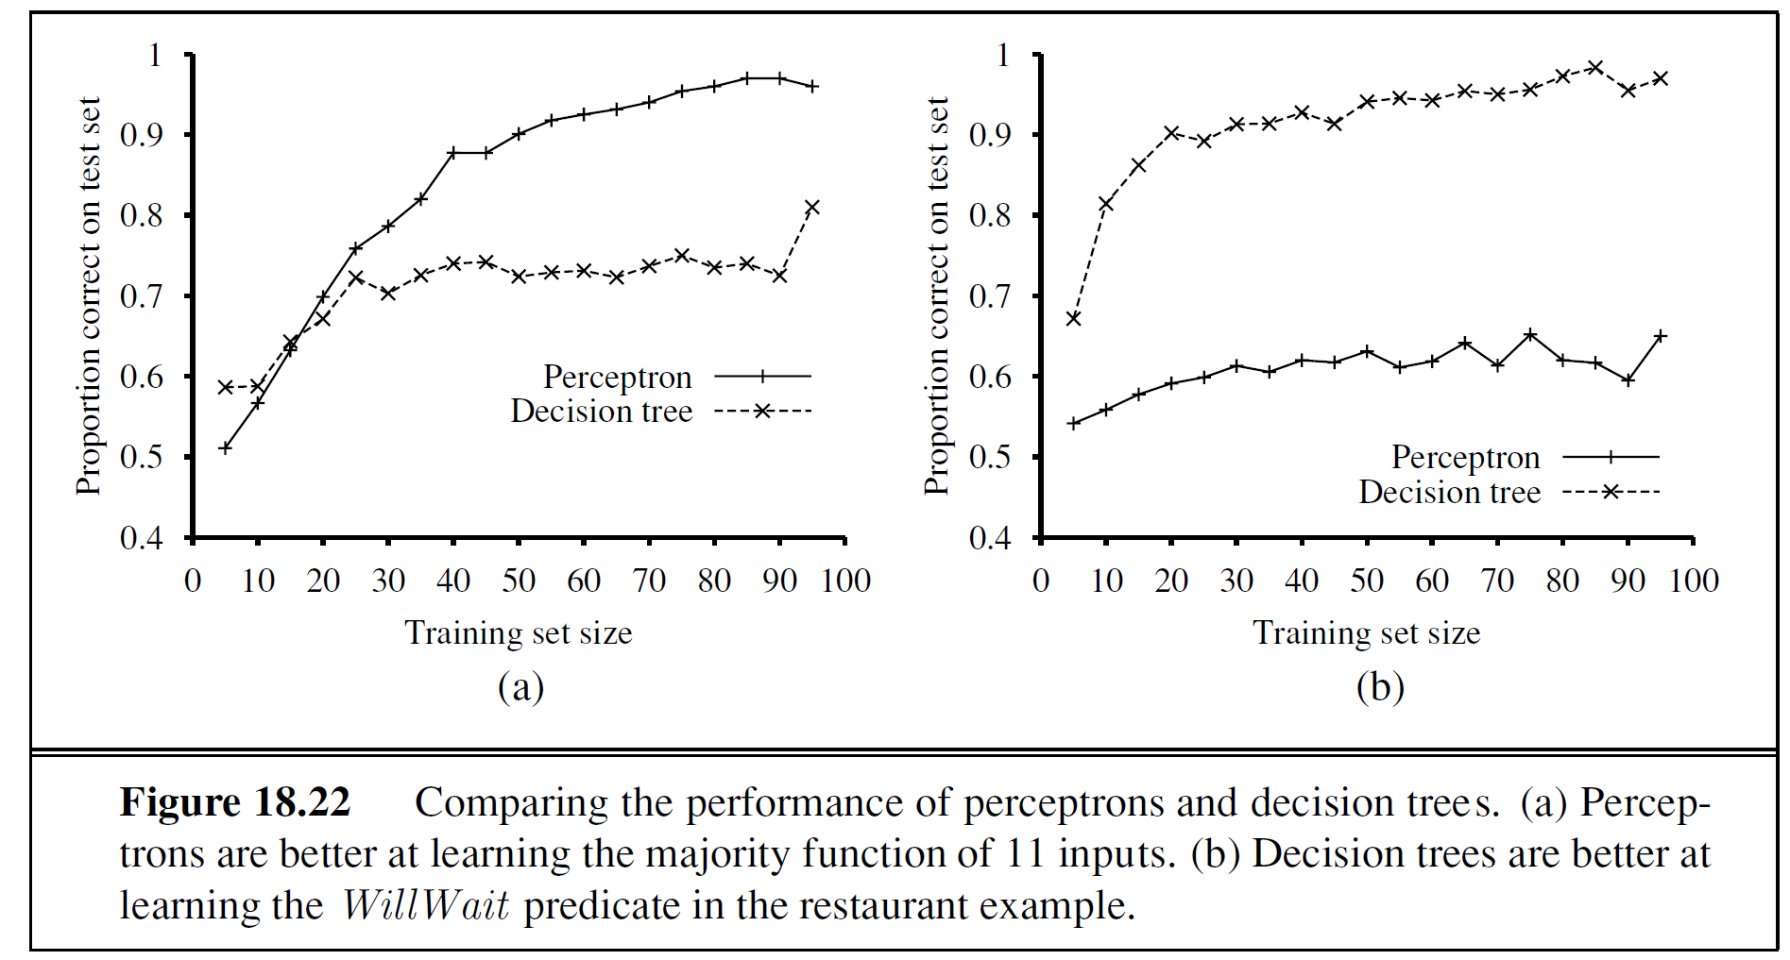
Perceptron network vs Decision Tree

Slide 24
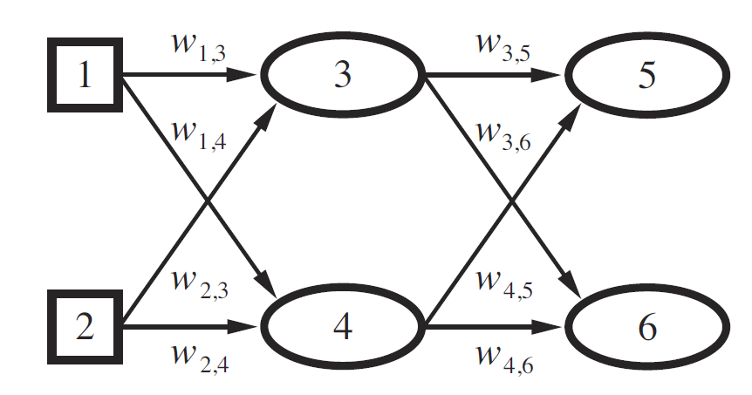
Multilayer feed-forward neural network
Input layer
Hidden layer
Output layer

Slide 25
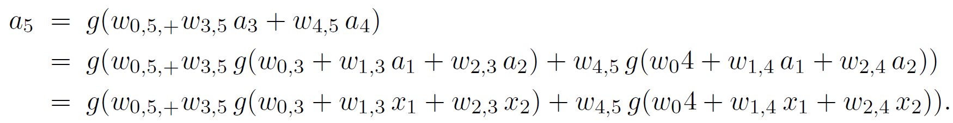
Multilayer feed-forward neural network
Input layer
Hidden layer
Output layer

Slide 26
Multilayer feed-forward neural network
Nonlinear
Input layer
Hidden layer
Output layer

Slide 27
Learning in multilayer networks
Input layer
Hidden layer
Output layer
Observation: output layer depends on all of the input-layer weights, so updates to those weights will depend on errors in both  and □.

Slide 28


Learning in multilayer networks
Back-propagate: the idea is that hidden node j is “responsible” for some fraction of the error Δ_{k} in each of the output nodes to which it connects.
Hidden layer and output layer
Err_{k} be the kth component of the error vector y − h_{w}

Slide 29
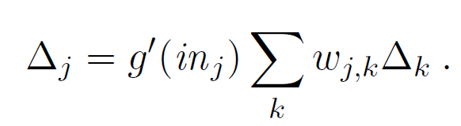

Learning in multilayer networks
Back-propagate: the idea is that hidden node j is “responsible” for some fraction of the error Δ_{k} in each of the output nodes to which it connects.
Hidden layer and output layer
Input layer and hidden layer

